Slide 1
The DeathWishers Final Project
Peer Evaluation Tool
Kevin Chen，Xiaoliang Chen，
Miles Lindgren，Salil Monga
Rahul Reddy
Notes:
good afternoon everyone! Today we are going to show the final project from our group - the Peer Evaluation Tool

Slide 2
Overview of the Presentation
Introduction
Client - View Demo
Setup
Peer - Evaluation Tool
Implementation
Database
Schemas
Architecture
Notes:
We will give a brief introduction to our application, and then show you the overall web page architecture of this tool, the database used and the general Schemas configuration

Slide 3
Introduction
Q：What is this project?
A：This project shows a tool that runs peer evaluation submitted by students and allows teachers to manage it.
Q：What can it do?
Students: Check if there is an evaluation of other team members
assigned and submit it
Faculties: Manage class students, groups, projects and all
evaluation submissions
Notes:
First of all, what is this project? Basically, this project provides a website for streamline the collection, collation, and analysis of peer evaluations. And different members have different permissions. For example, students can only check whether they are assigned to peer evaluation and complete them. While teachers can assign evaluations to students and have the right to edit class students, groups, projects, and all evaluation submissions. within a class.

Slide 4
Client View Demo
Steps for Setup:
Install Ruby and Rails
Pull project from Github
Open terminal and navigate to the project folder
Type in ‘$bundle install’
Type in ‘$rails db:migrate’
Type in ‘$rails server’
Open browser and navigate to ‘localhost:3000’

Slide 5
Peer - Evaluation Tool
HomePage
Student Page
Login & Sign Up
Evaluation Survey
Faculty Page
Manage Students
Manage Groups
Manage Projects
Manage Evaluation Submissions
Notes:
While different roles will lead to different interfaces. For students, first they have to log in or register their account to see if they have tasks that need to be evaluated. Teachers can click the "I’m a faculty" button to lead to the class management page. Here, teachers can manage all the information about students, groups, projects and evaluation in the class.

Slide 6
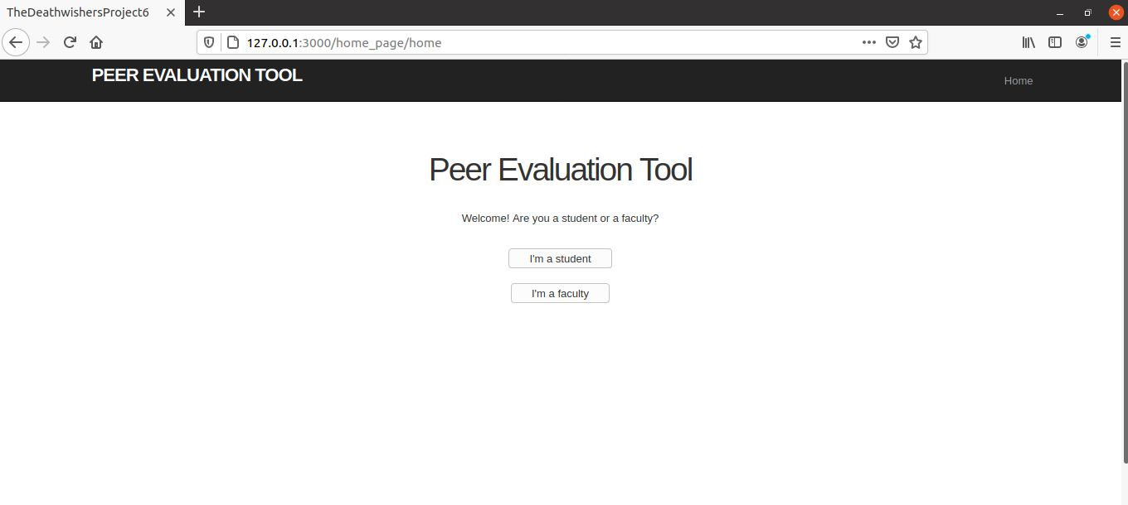
Homepage example display
Notes:
Here is the homepage of this tool. As you can see, when logging in to the homepage, you need to choose whether you are a student or a teacher to lead you to a different page.

Slide 7
Implementation
To understand the project from an implementers point of view, let us take a look at the detailed architecture, database schemas and how everything is connected.

Slide 8
Data Base Tables
Students
Student Groups
Projects
Evaluations
Users
Notes:
In this project, our team cited five databases, called students, groups, Projects, Evaluations Submission and User.

Slide 9
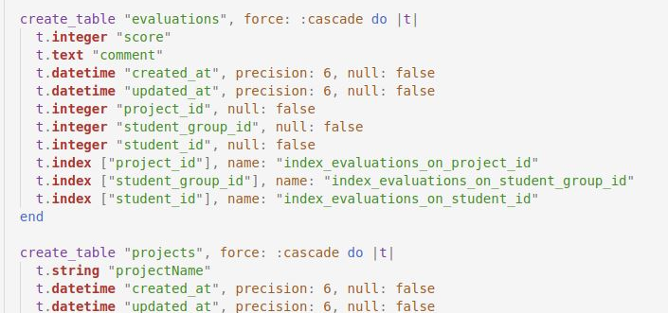
DataBase Schemas—Part I

Slide 10
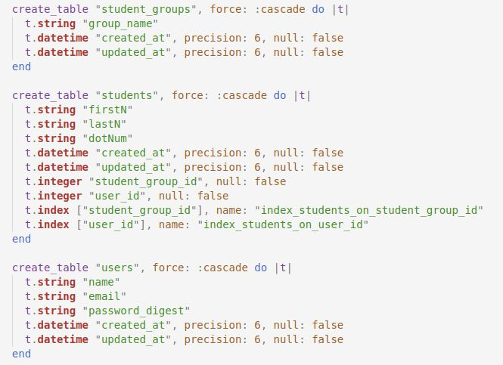
Database Schemas—Part II

Slide 11
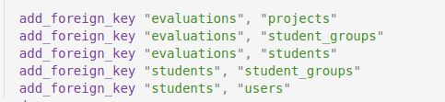
Database Schemas—Part III

Slide 12
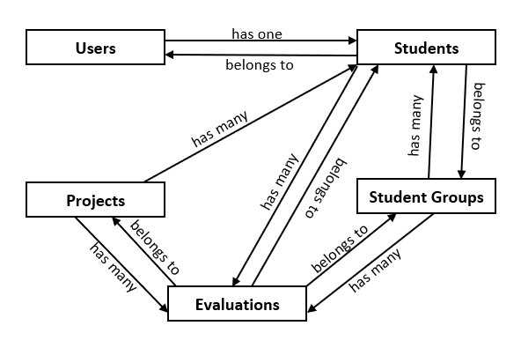
Table Links

Slide 13
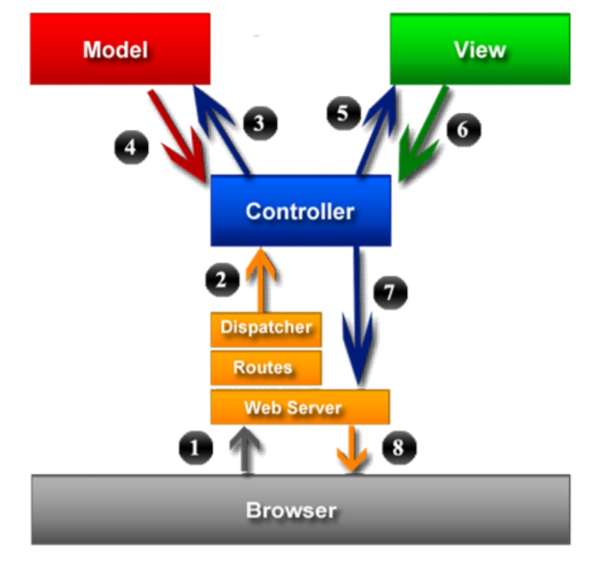
MVC Architecture

Slide 14
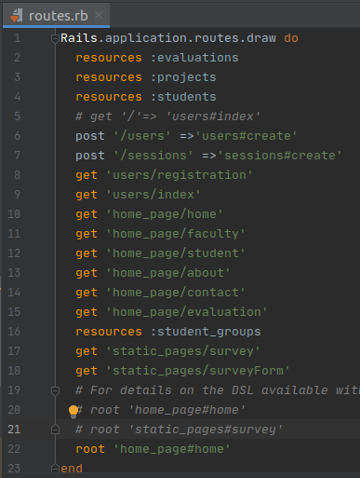
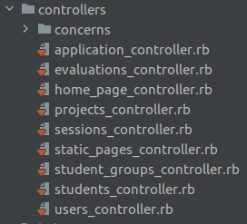
Routes
Controllers

Slide 15
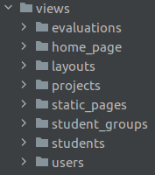
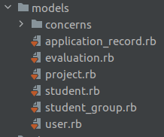
Views
Models

Slide 16

Thank You!

